Slide 1


Slide 2
Profit maximization and price discrimination
Market segmentation or cost leadership?
Stuck in the Middle?
Entering competitor’s segments

Slide 3
Market segmentation
Minivan
SUV
Interior
space
Luxury
Sedan
Sub-compact
Sports cars
MPG

Slide 4
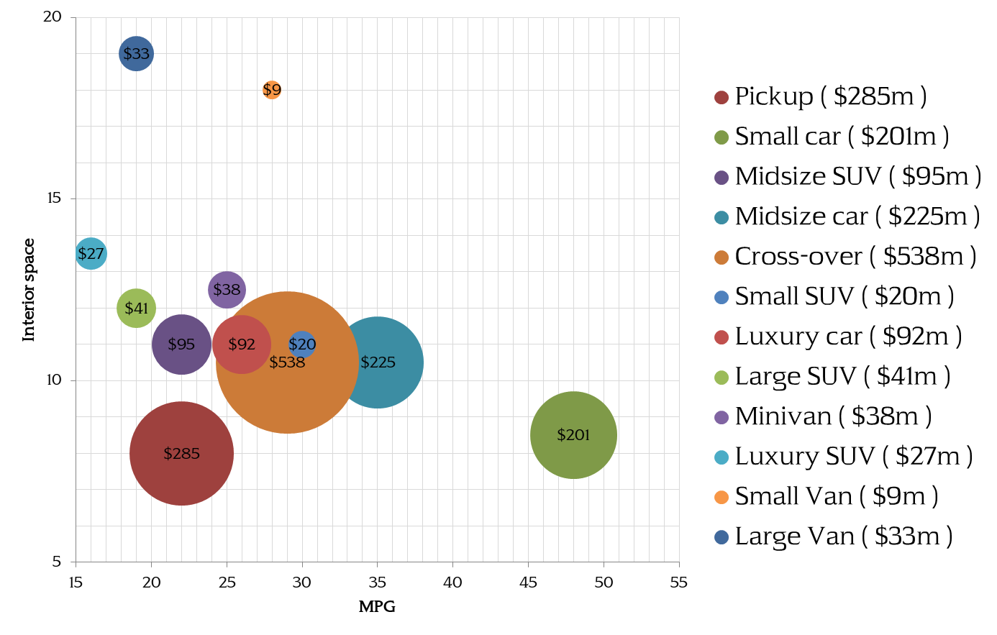
Market segmentation
http://www.wsj.com/mdc/public/page/2_3022-autosales.html
https://www.avis.com/en/reservation#/vehicles

Slide 5
Generic Strategies
Entire market
Part of the market
Full line segmentation
High value niche
Meeting
segment
needs
Ford, GM…
McLaren, Morgan
Cost leader
Low price niche
Manufacturing
Efficiency
Fort (Model T)

Slide 6
Profit maximization, no segmentation
Price
P*
One big segment
(Ford Model T)
Cost
quantity

Slide 7
Profit maximization, no segmentation?
Price
Luxury
Mid
range
P*
Compact
Cost
quantity

Slide 8
Profit maximization, no segmentation?
Key
Price
Niche segmenter
Niche cost leader
Firm 1
Luxury
Firm 2
Mid-
range
P*
Firm 3
Compact
Cost
quantity

Slide 9
Profit maximization, no segmentation?
…But costs will rise with smaller production volumes
Price
Luxury
Mid
range
Compact
quantity

Slide 10
Intermediate Summary 1
Two broad generic strategies
  Segmentation & Cost leadership
Each comes in two ‘flavors’,
  Covering the entire market and addressing only a small niche
Segmentation approaches price discrimination (like an auction)
  Maximizes firm appropriation
  Can serve to reduce segment competition

Slide 11
Which to choose?
First, are there distinct market segments?
Next…
  Need to research the value created with increasing variety…
  And the associated increase in production costs

Slide 12
A product market, one segment
Value ($)
Everyone likes red cars. No segmentation possible
e.g.
Aluminum baking foil
Dry wall
Car color

Slide 13
A market with two segments
Should the market be segmented?
Value ($)
People who prefer
red cars
People who prefer
blue cars
Color

Slide 14
Segmentation?
Value ($)
People who prefer
red cars
People who prefer
blue cars
Color

Slide 15
Price rises faster than cost
Differentiation
Price
Cost
1
2
3
4
5
6
7
8
9
Number of product variants

Slide 16
Price / cost leadership
Value ($)
People who prefer
red cars
People who prefer
blue cars
Value with segmentation
Value without segmentation
Color

Slide 17
Costs rise faster than price
Cost
leadership
Price
Cost
1
2
3
4
5
6
7
8
9
Number of product variants

Slide 18
Segmented markets
Red car market
Blue car market
Value
Value
Q/2 cars
Q/2 cars
P
P
Total market for Q cars
Cost
Cost
Red cars
Blue cars

Slide 19
You can have any color you like…
…as long as its magenta
Red car market
Blue car market
OR…
V
Q/2 cars
V
Q/2 cars
P
P
V
Q cars
C
P
C
C
Red cars
Magenta cars
Blue cars

Slide 20
Costs rise faster than price
Price
“Stuck in the middle”
Cost
Not enough scale to generate low costs
Not enough variety to meet customer needs, create value
1
2
3
4
5
6
7
8
9
Number of product variants

Slide 21
Increasing flexibiltiy
Building two models meant either having sufficient volume for a dedicated line or changing the dies on a single line
In the 1980s, it took Ford, Chrysler or GM 8 hours to change a body stamping die.
Toyota saw that the obstacle to greater variety (increasing costs) could be reduced if die changing times were cut:
  to 10 minutes (Ten Minutes Exchange of Dies)
  and later to a single minute (SMED)
Notes:
Section 5 to here

Slide 22
Other Advances
Computer aided design (CAD) and computer aided manufacturing (CAM)
Robots can switch effortlessly from one model to another
Shared 'platform' (common components, chassis / drive train: Trucks == SUV
While the initial investment may be large, once made variety is ‘costless’

Slide 23
Flexible manufacturing…
Differentiation
Cost
leadership
Old Cost
Price
New Cost
1
2
3
4
5
6
7
8
9
Number of product variants

Slide 24
Two market segments
and two producers with differentiated / segmented products
Red car market
Blue car market
Total market for Q cars
Red car company
Blue car company
Notes:
Section 7 to here

Slide 25
The two companies…
V
V
Q/2 red cars
Q/2 blue cars
P
P
C
C
Red car company
Blue car company

Slide 26
Each company adds a new product
…to enter its competitor’s segment
Red car market
Blue car market
Red (and blue) car company
White (and red) car company
Notes:
Section 7 to here

Slide 27
Unit costs rise
…as each line is working at half capacity
V
V
-> Q/4 cars
Q/4 cars
-> Q/4 cars
Q/4 cars
P
P
P
P
C
C
C
C
Red (and blue) car company
Blue (and red) car company

Slide 28
Prices decline
…as customers now have a choice and manufacturers compete directly
V
V
-> Q/2 cars
Q/2 cars
-> Q/2 cars
Q/2 cars
P
P
P
P
C
C
C
C
Red (and blue) car company
Blue (and red) car company

Slide 29
Segmentation
When customers’ needs are not homogeneous…
  Segmentation and tailoring products to each segment leads to higher value being created for customers
  However, does this lead to higher profits?
  Need to consider
    Cost of variety
    Ability to appropriate (segment competition)

Slide 30
Summary
Four generic strategies
  Full line segmentation
  Entire market cost leadership
  High value niche market
  Cost leader niche market
Lowering costs (E.O.S) often requires high volume
  Variety means lower volume thus higher costs
  Cost leadership and product variety (segmentation) are/were almost mutually exclusive → “Stuck in the middle”
Flexible manufacturing and quality
  Less impact on cost from increasing variety
  Makes segmentation possible in market that were previously too small

Slide 31


